Slide 1
SWE3002: Information & Systems Security
Module 1 Fundamentals of Security
Prof. Jayasudha M, VIT Chennai

Slide 2
Overview
Goals of Information Security
Attacks on Different Layers
Attacks Examples
Trusted Network
Access Control
Cryptography
Public Key Infrastructure

Slide 3
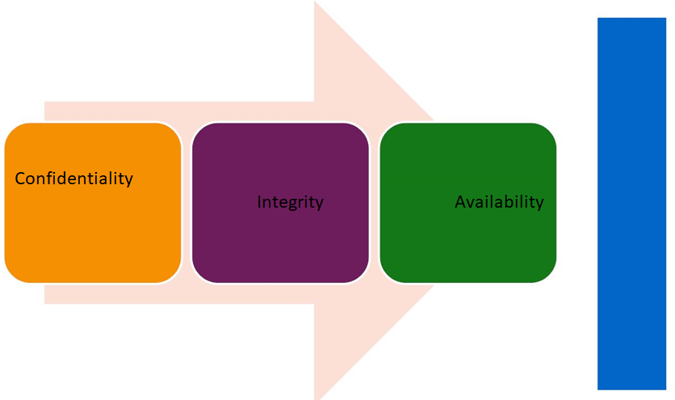
Goals of Information Security

Slide 4
Why Security?
The Internet was initially designed for connectivity
Fundamental aspects of information must be protected
We can’t keep ourselves isolated from the Internet

Slide 5
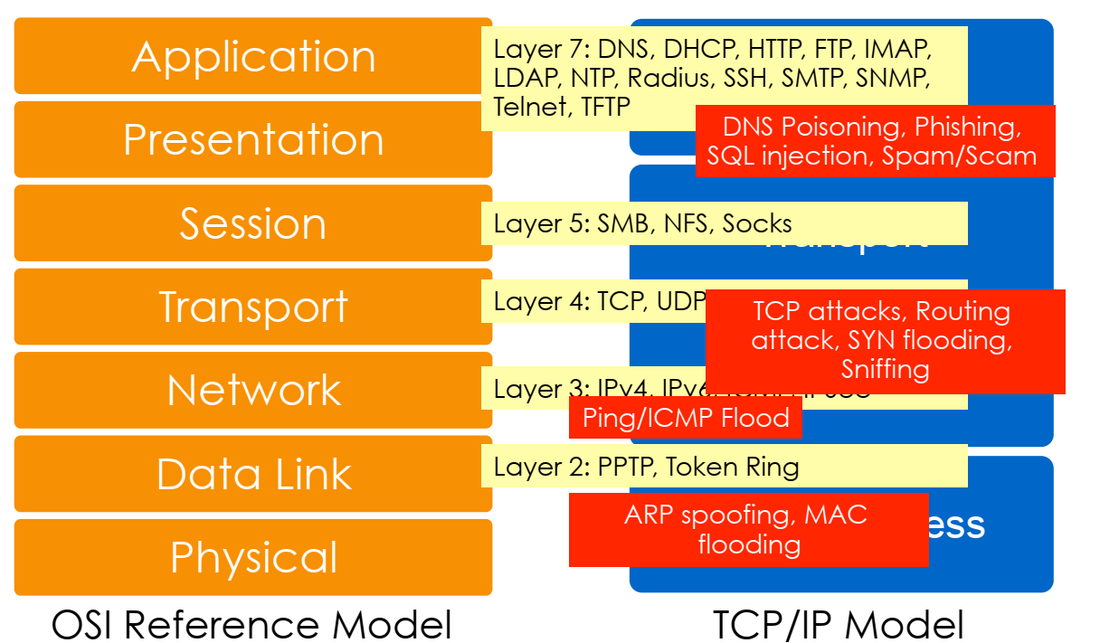
Attacks on Different Layers

Slide 6
Common Types of Attacks
Ping sweeps and port scans
Sniffing
Man-in-the-middle attack
Spoofing
Hijacking
Denial of Service (DoS) and Distributed DoS (DDoS)

Slide 7
OSI security architecture
Architecture focuses on security attacks, mechanisms, and services
1. Security attack
Passive attacks
Active attacks
2. Security mechanism
3. Security service

Slide 8
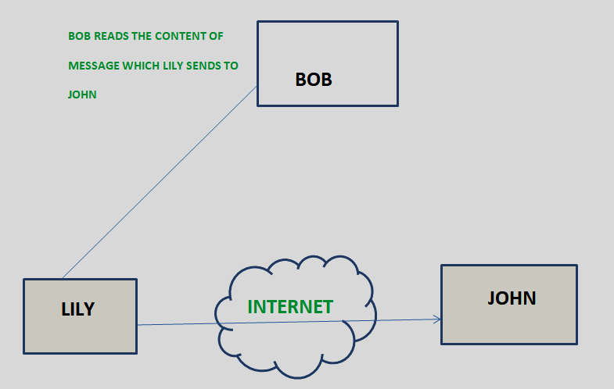
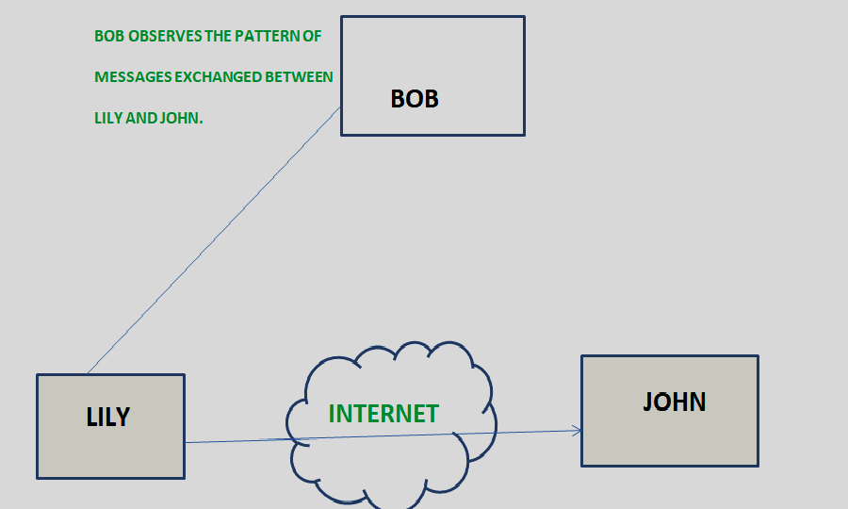
1. SECURITY ATTACKS: Passive Attacks
Release of message contents
Traffic analysis

Slide 9
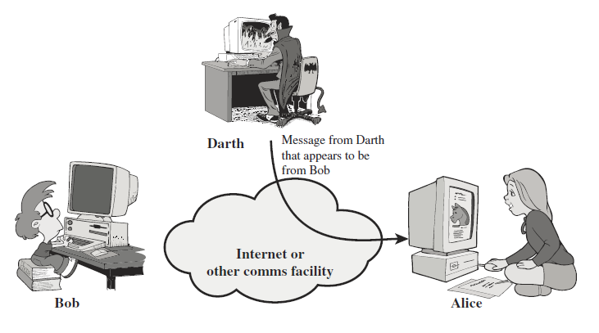
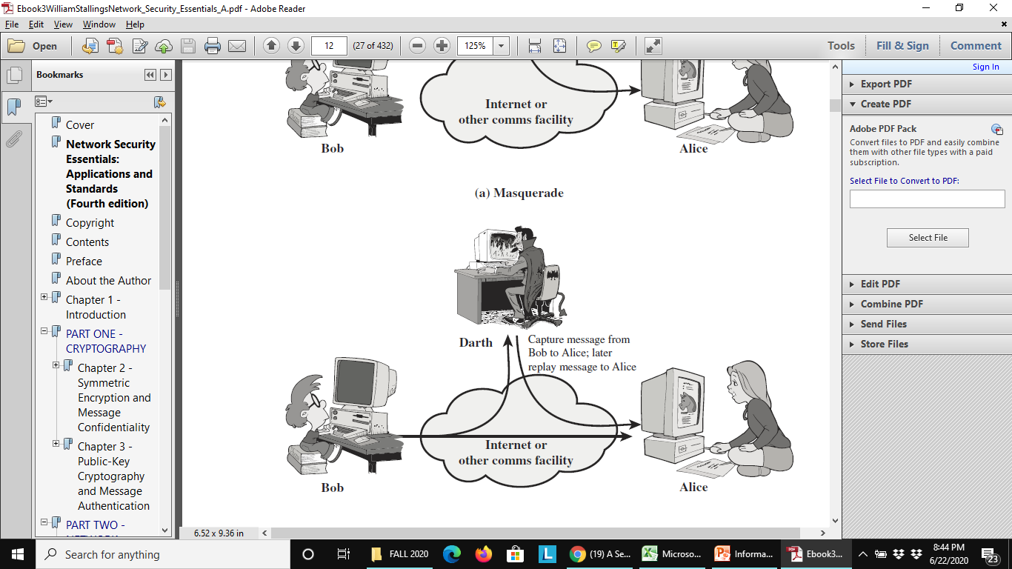
1. SECURITY ATTACKS: Active attacks
Masquerade Replay

Slide 10
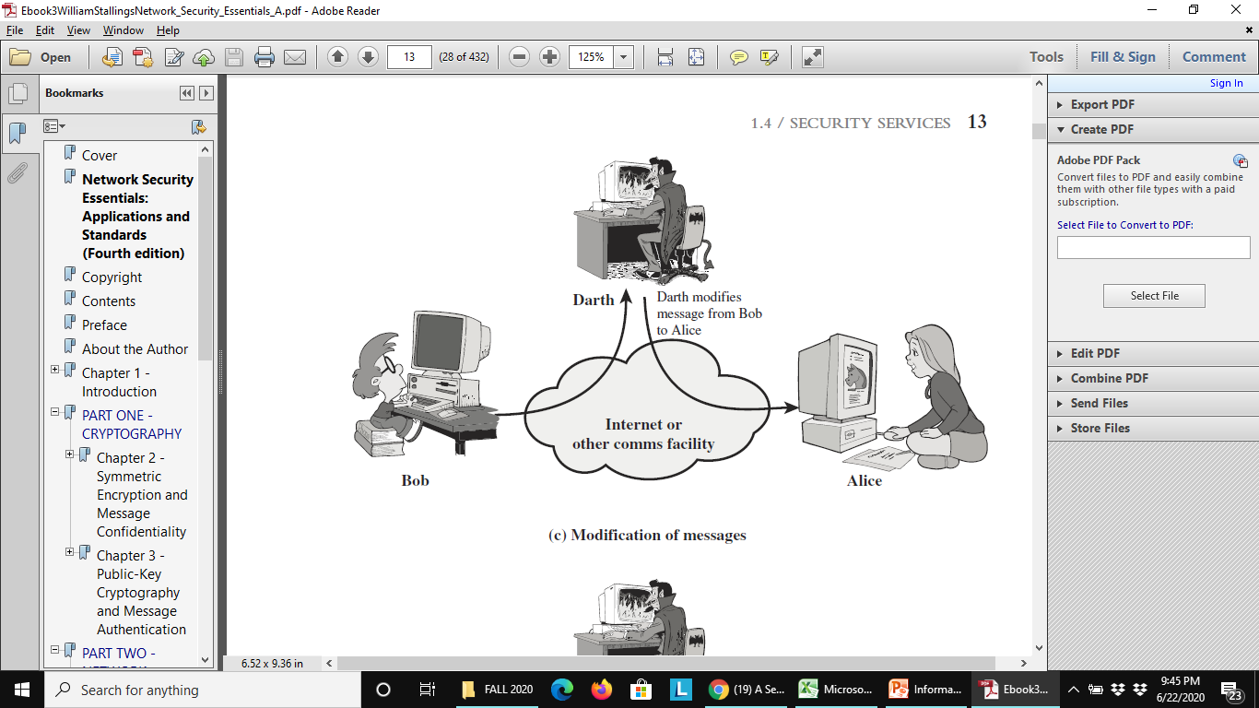
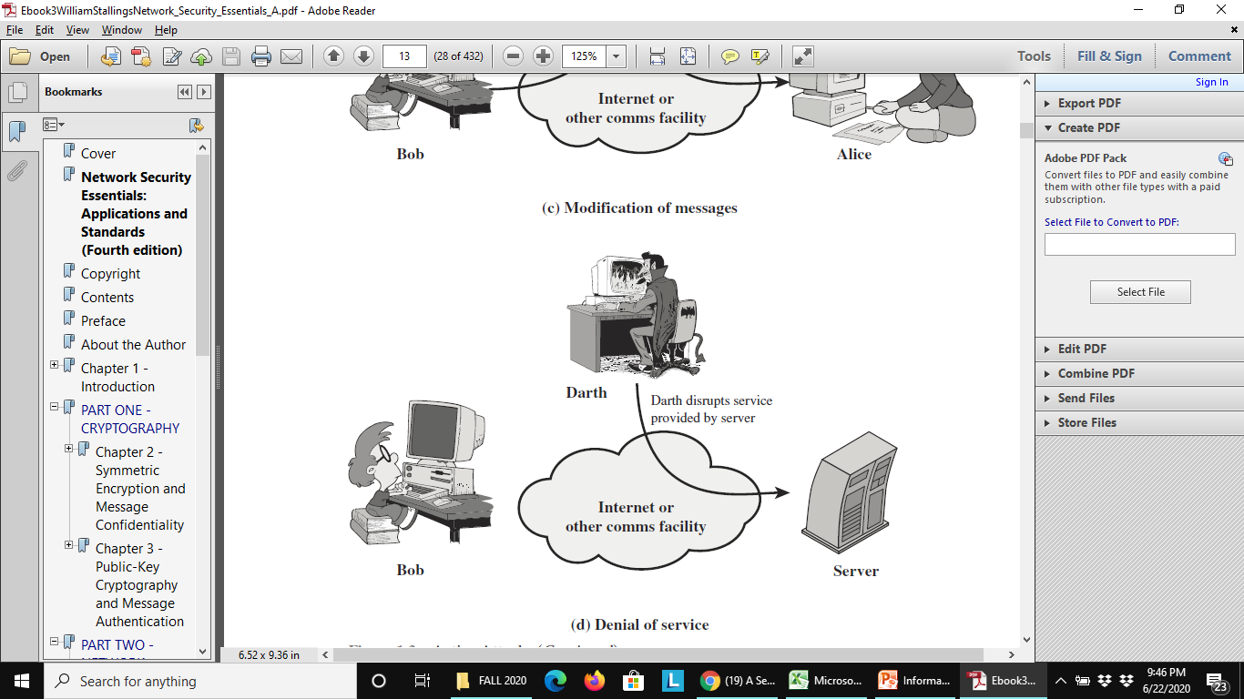
1. SECURITY ATTACKS: Active attacks
Modification of messages Denial of service

Slide 11
2. Services Mechanisms
Security mechanisms defined in X.800 are:
Specific security mechanisms:
Encipherment, digital signature, access control, data integrity, authentication exchange, traffic padding, routing control, and notarization.
Pervasive Security Mechanisms:
Trusted functionality, security label, event detection, security audit trail, and security recovery

Slide 12
3. SECURITY SERVICES
X.800 defines a security service five categories and fourteen specific services:
Authentication: Peer Entity Authentication and Data-Origin Authentication
Access control
Data confidentiality: Connection, Connectionless, Selective-Field and Traffic-Flow Confidentialities
Data integrity: Connection Integrity with Recovery, Connection Integrity without Recovery, Selective-Field Connection Integrity, Connectionless Integrity and Selective-Field Connectionless Integrity
Nonrepudiation: Nonrepudiation(Origin), and Nonrepudiation(Destination)

Slide 13

Security policies
A set of rules enacted by an organization to ensure that all users or networks of the IT structure within the organization’s domain abide by the prescriptions regarding the security of data stored digitally within the boundaries the organization stretches its authority..

Slide 14
Security policies
Elements of Information Security Policy
To establish a general approach
To detect and forestall the compromise of information security such as misuse of data, networks, computer systems and applications.
To protect the reputation of the company with respect to its ethical and legal responsibilities.
To observe the rights of the customers; providing effective mechanisms for responding to complaints and queries concerning real or perceived non-compliances with the policy is one way to achieve this objective.

Slide 15
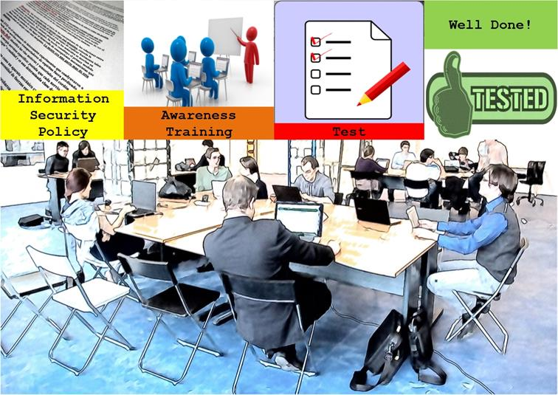
Information Security policies
Information security objectives
Authority & Access Control Policy
Classification of Data
Data Support & Operations
Security Awareness Sessions
Responsibilities, Rights and Duties of Personnel

Slide 16
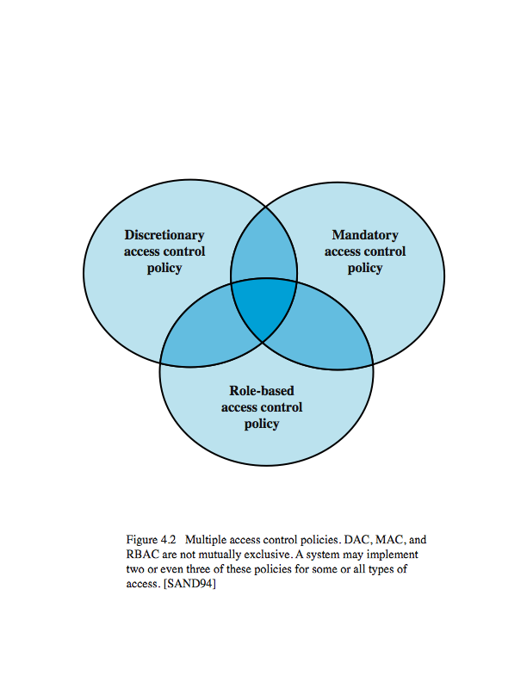
Access Control
“The prevention of unauthorized use of a resource, including the prevention of use of a resource in an unauthorized manner“
Access control principles:
Authentication
Authorization
Audit

Slide 17
Access control structures
Mechanisms for implementing access policies like:
Discretionary access control (DAC): Access control matrix is often sparse
can decompose by either row (capability lists) or column (Access control lists - ACLs)
Mandatory access control (MAC)
Role-based access control (RBAC)
Intermediate controls (groups, negative permissions, roles, protection rings etc.)
Requirements for access control structures: an ability to express control policies verifiability of correctness. scalability and manageability

Slide 18
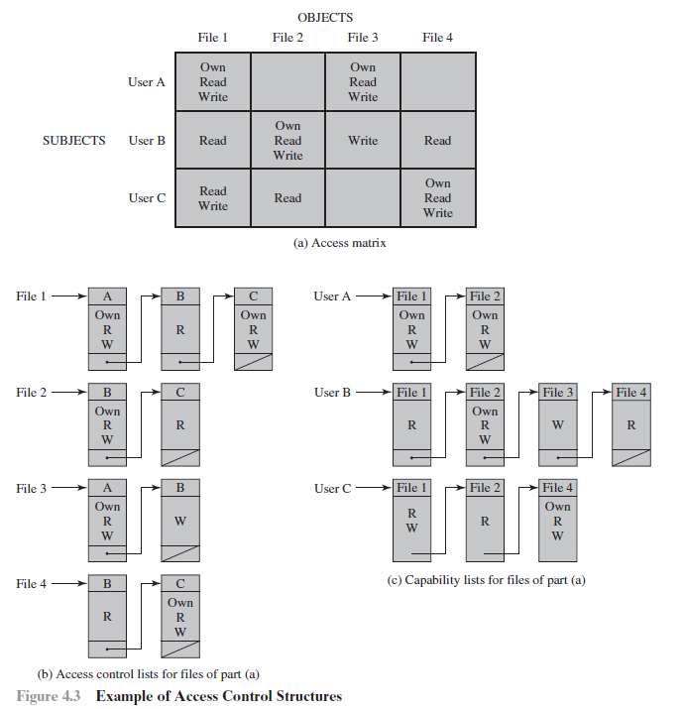
Access Matrix for 3 users and 4 files

Slide 19
Access Control List for files

Slide 20
Capability list for files

Slide 21
Access Control Structures

Slide 22


